Slide 1

McGraw-Hill Technology Education
Copyright © 2006 by The McGraw-Hill Companies, Inc. All rights reserved.

Slide 2
Chapter 8A
Productivity Software

Slide 3
Acquiring Software
Commercial software
  Software that must be purchased
  Stand alone products
    Solve one type of problem
  Software suites
    Integrated tools that work together
    Solve many problems
  Shareware
    Try before you buy
    May deactivate if not purchased
Notes:
Teaching tip
An excellent example is to create a letter in Word. Then in Excel, create a simple spreadsheet. Link the spreadsheet into the letter. Arrange both products on the screen. Change the spreadsheet and the letter should update automatically.

Slide 4
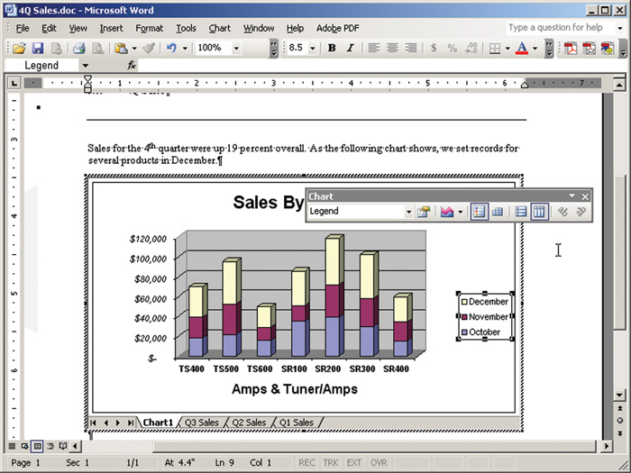
Software Suite

Slide 5
Acquiring Software
Freeware
  No obligation to purchase
    Donations often accepted
  Software may be distributed freely
  Public domain software
Notes:
Teaching tip
The best piece of freeware on the market is spy-bot. Spy-bot is an excellent tool for stopping and removing spyware products on your computer. Get a copy at http://www.safer-networking.org/en/index.html. Patrick Kolla, the author, asks for an optional donation to cover costs.

Slide 6
Acquiring Software
Open source
  Programs distributed with source code
  Allows users to modify the software
  Modifications and comments are welcome
  Linux and OpenOffice
Notes:
Discussion point
A student once told me that Windows and Linux cost the same – they are free. Use this statement as a springboard to discuss the problems of piracy with your students. Demonstrate the loss of revenue a company faces due to piracy. Demonstrate the security risks the students take when pirating software.

Slide 7
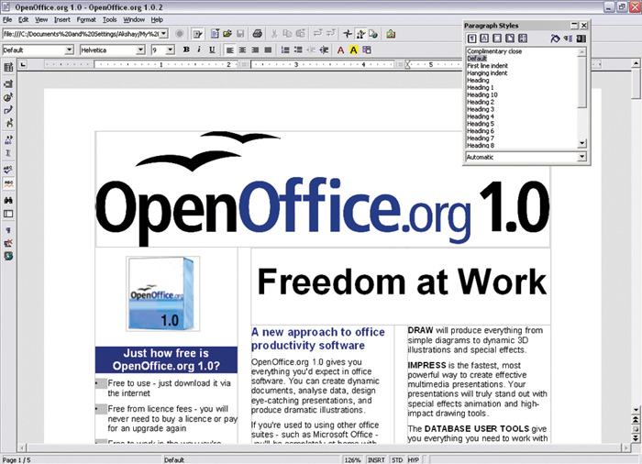
Open Office

Slide 8
Word Processing Programs
Creates text documents
Graphics and other objects are supported
Professional quality can be achieved
Simple web pages may be created

Slide 9
Word Processing Programs
Interface
  Document area
  Menu bar
  Toolbars
  Rulers
  Scroll bars
  Status bars

Slide 10
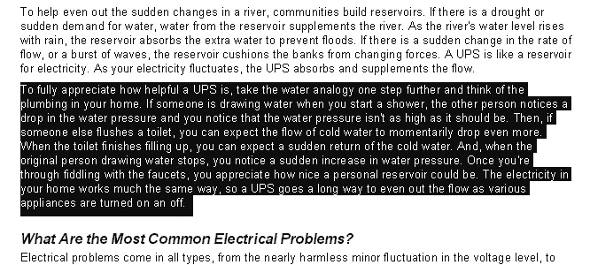
Word Processing Programs
Entering and editing text
  Text is entered by typing
  Cursor indicates position
  Blocks of text can be manipulated
  Most other programs include text tools
Notes:
Teaching tip
To select a paragraph using the mouse, triple click any word in the paragraph. Double clicking selects the word.

Slide 11
Word Processing Programs
Formatting text
  Controls the document’s appearance
  Character formatting tools
    Fonts
    Type style
  Paragraph formatting tools
    Line spacing
    Tabs
  Document formatting tools
    Margins
    Headers
Notes:
Teaching tip
Point out to your students that the simple word processor is the most often used application in most offices.

Slide 12
Spreadsheet Programs
Calculates numbers and finances
Data viewable in many ways
  Tables
  Graphs
Complex calculations can be automated

Slide 13
Spreadsheet Programs
Interface
  Rows, columns and cells
    Cell holds data or formulas
  Formula bar
  Labels describe cell contents
  Values
  Dates
  Formulas
Notes:
Teaching tip
Open Excel in your class and demonstrate the power of a formula. I often use the financial formulas to calculate credit card payment amounts and the future value of investments.

Slide 14
Presentation Programs
Creates slides or transparencies
Complete set is a presentation
Enhances a speech or lecture
Color and animation enhance the slides

Slide 15
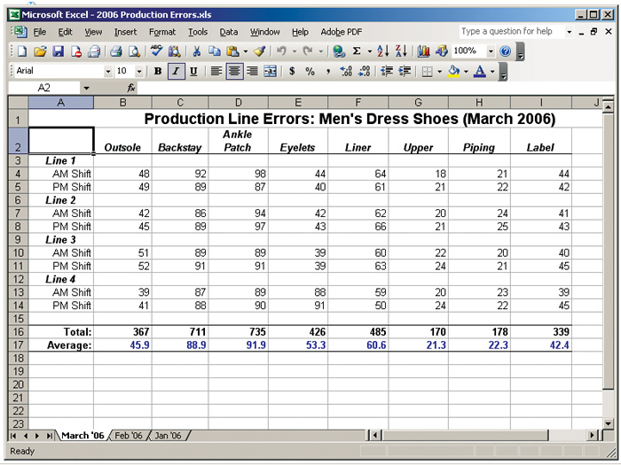
Spreadsheet Interface

Slide 16
Presentation Programs
Interface
  Similar to a word processor
  Slide window
  Outline window
  Speaker notes

Slide 17
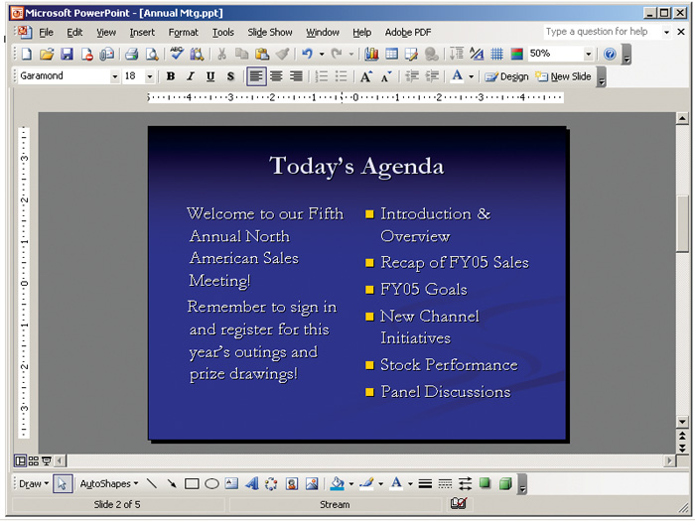
Presentation Interface

Slide 18
Presentation Programs
Creating a presentation
  Templates can simplify the process
  Build the slides
    Pick a layout
    Enter the desired text
    Apply special formatting
  Continue adding slides in order
  Apply slide transitions if desired
Notes:
Teaching tip
Point out to the students that templates can be found in nearly all office products.

Slide 19
Presentation Programs
Presenting slide shows
  Use to enhance a speech
  Mouse click advances to next slide
  Physical transparencies on an overhead
  Computer screen delivery
  Large monitor delivery
  Data projector

Slide 20

Using a Large Monitor

Slide 21
Personal Information Managers
PIM software
Keep track of contact information
Track upcoming events and times
MS Outlook is popular

Slide 22
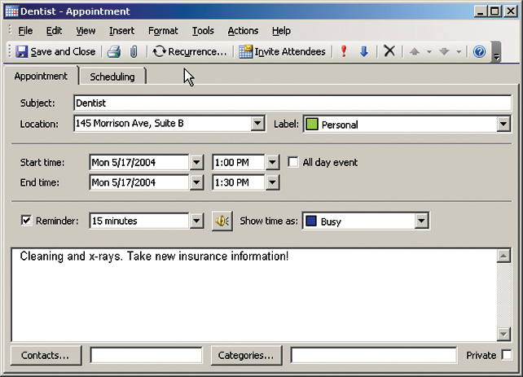
Personal Information Managers
Data organization
  Contact information organized by last name
  Users may search for data
  Appointment reminders can be set

Slide 23
Chapter 8A
End of Chapter

